Slide 1

Deep Learning Project Report
Towards Lightweight Human-Level AI in Spades
Deep Learning Project Report
Project Members
Haoren Luo, Bangjie Xu, Yueyang Wang
Goal: Achieving human-level AI performance in Spades.
Approach: Hybrid architecture bridging RL and exact search solvers.
Result: Human-level performance with under 5s execution on a single CPU core.
Deep Learning Project Report
2026-06-06

Slide 2
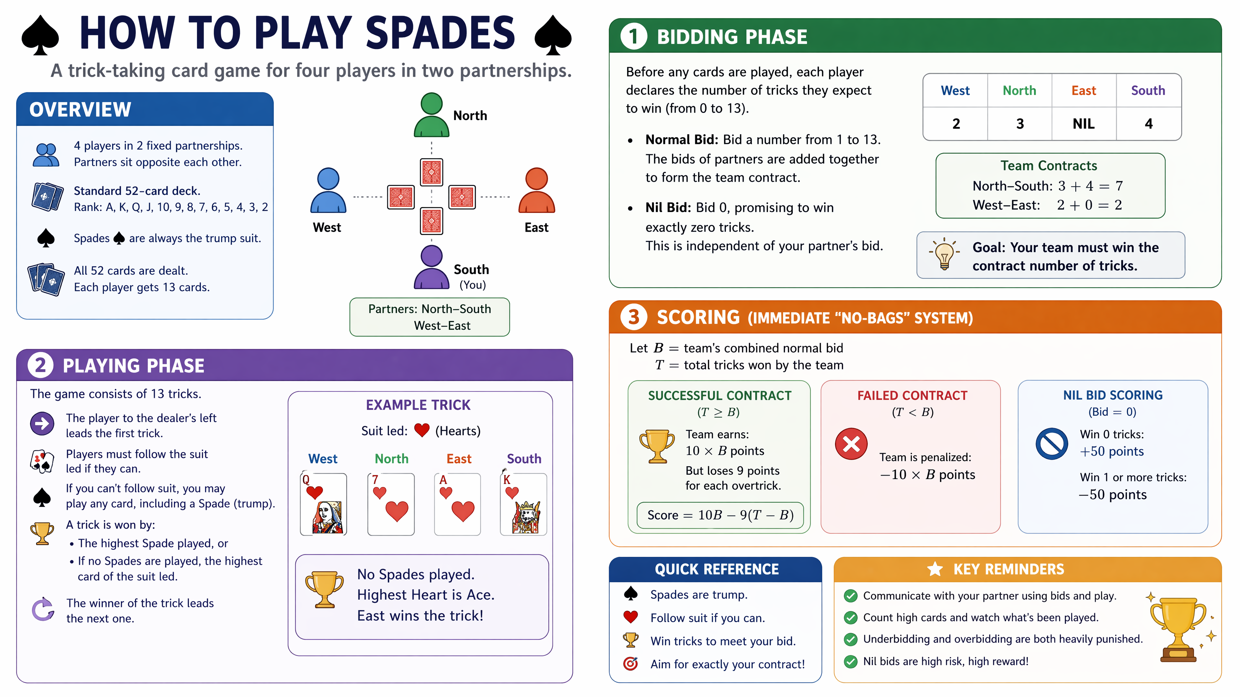
Spades Rules Crash Course
Deep Learning Project Report
2026-06-06
Notes:
分为叫牌和出牌两个部分。小于，巨大惩罚。大于，巨大奖励，超墩惩罚。记得提及叫0.

Slide 3
The Challenges Of Spades AI
Complex state spaces and non-linear logic in multi-agent environments
Massive Imperfect Information
Management of hidden state spaces and complex hidden hand distributions requires robust belief modeling.
Non-Linear Scoring Dynamics
Nil bids and immediate overtrick penalties demand extreme precision; small tactical errors lead to catastrophic point loss.
Endgame Reasoning
End-to-end Deep Reinforcement Learning often fails to execute the precise logical reasoning required for late-game card counting.
Deep Learning Project Report
2026-06-06

Slide 4
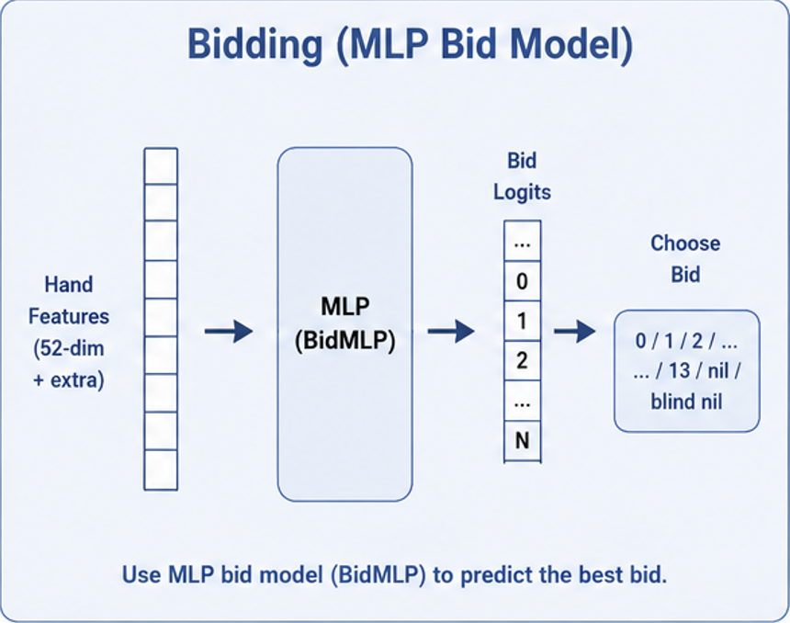
Neural Bidding Architecture
Multi-stage training for Spade's bidding policy
Architecture Details
Model Structure: 4-layer MLP designed to predict probabilities for Normal and Nil bids simultaneously.
Training Pipeline
1. Supervised Pre-training: Initializing weights using the DDS (Deep Deal Simulator) expert dataset to learn basic game conventions.
2. RL Fine-tuning: Utilizing Neural Fictitious Self-Play (NFSP) to optimize strategic decision-making and robustness against diverse opponents.
Deep Learning Project Report
2026-06-06

Slide 5
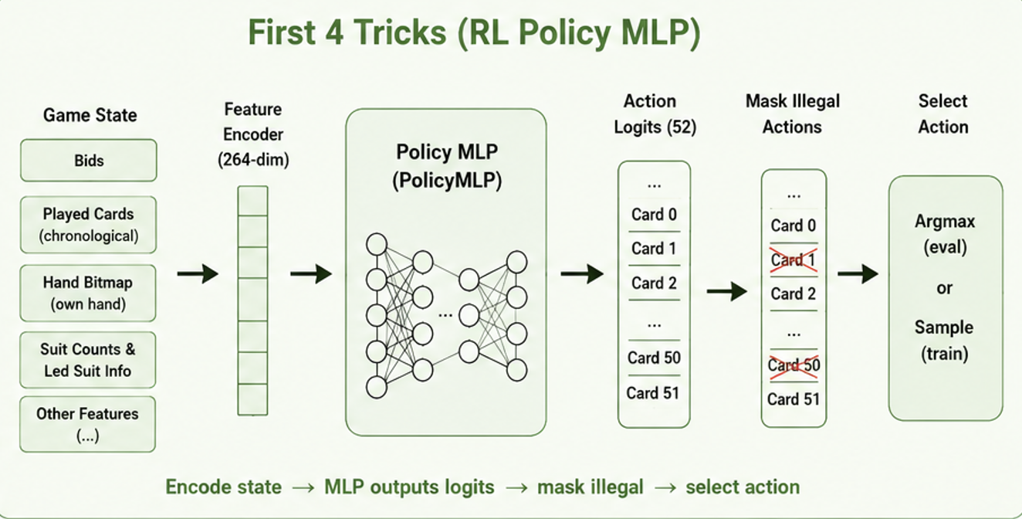
Reinforcement Learning Policy
Early-game strategy and architectural efficiency
Policy Scope: Focuses on executing the first 4 tricks of the game to establish lead.
State Encoding: Utilizes a 264-dimensional public vector for environment observation.
Training Efficiency: Achieves 20-minute convergence via optimized reward shaping.
Deep Learning Project Report
2026-06-06

Slide 6
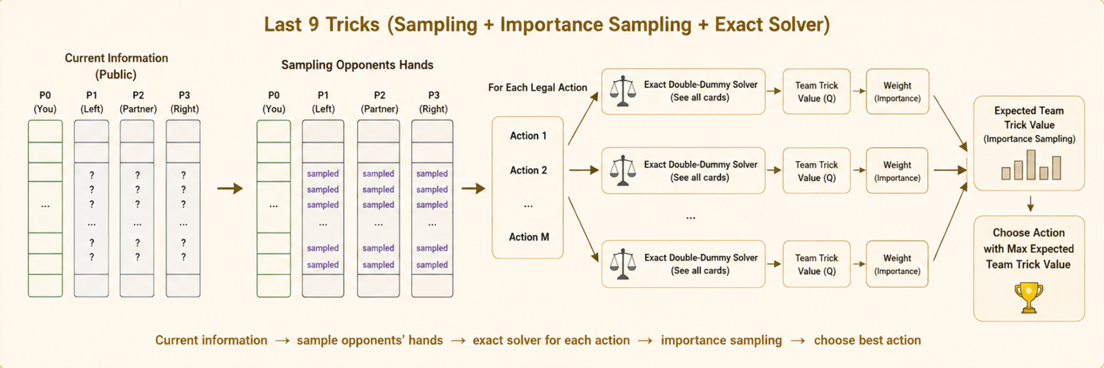
Exact Solver Phase
High-precision endgame optimization
Determinization: Parallel execution of 6,789 hand allocations to resolve information sets.
Sampling: Dynamic pruning of the state space to focus on the top 32 highest-probability hands.
Alpha-Beta Search: C++ implementation optimizing for non-linear scoring functions during deep lookahead.
Deep Learning Project Report
2026-06-06

Slide 7
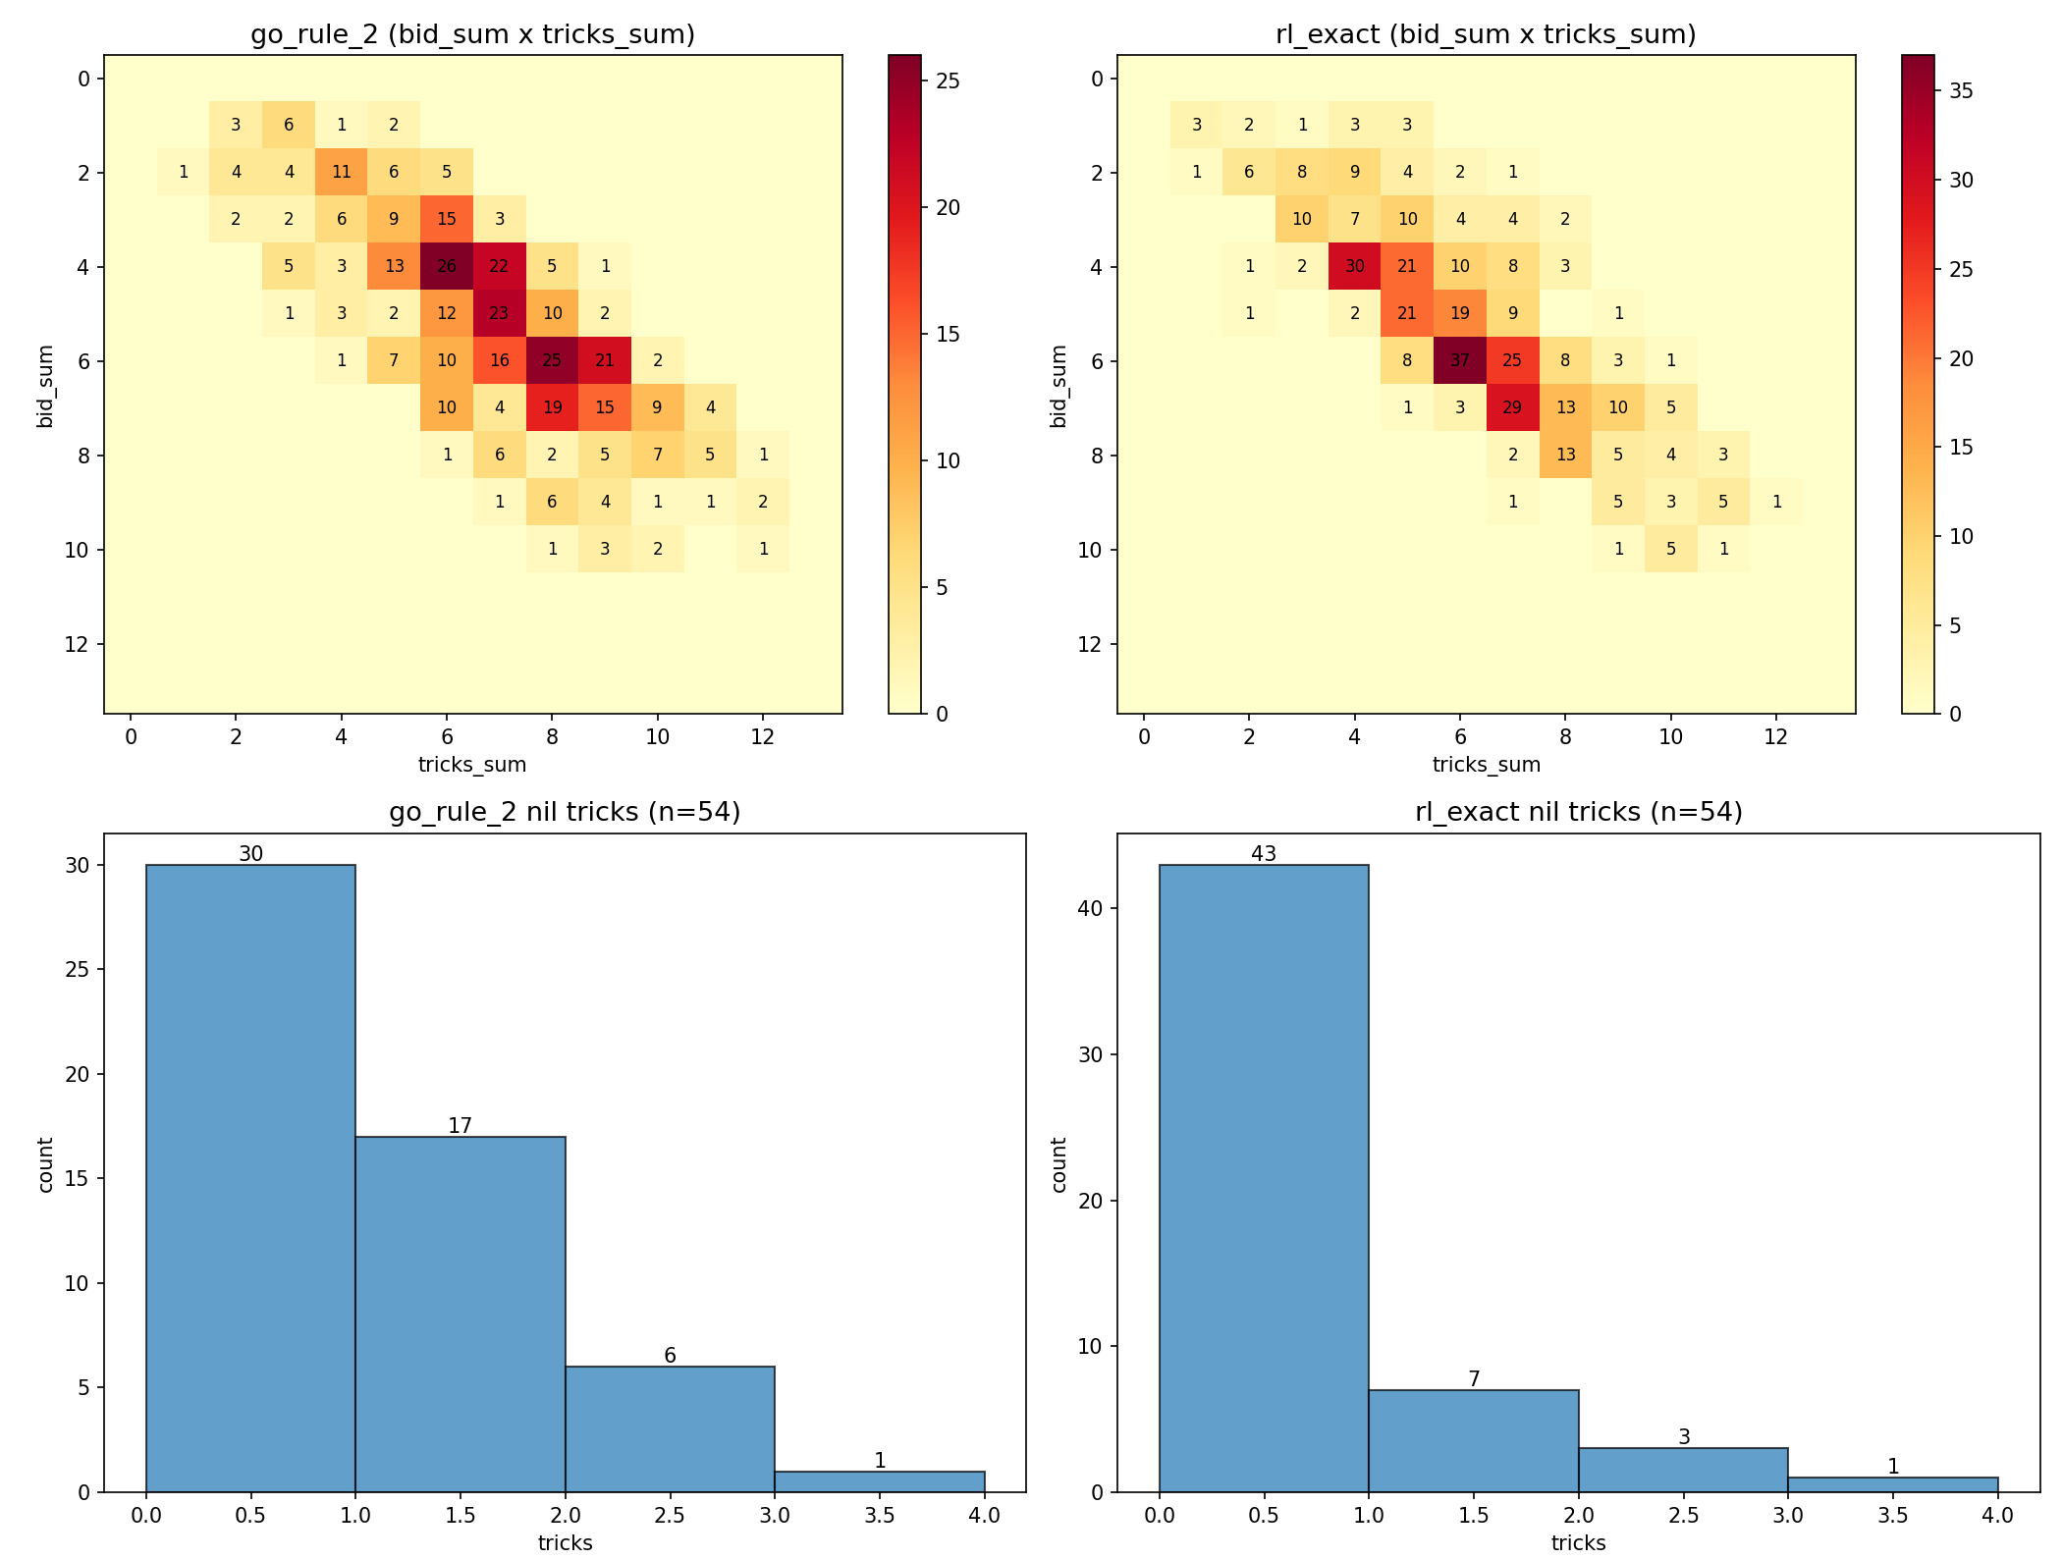
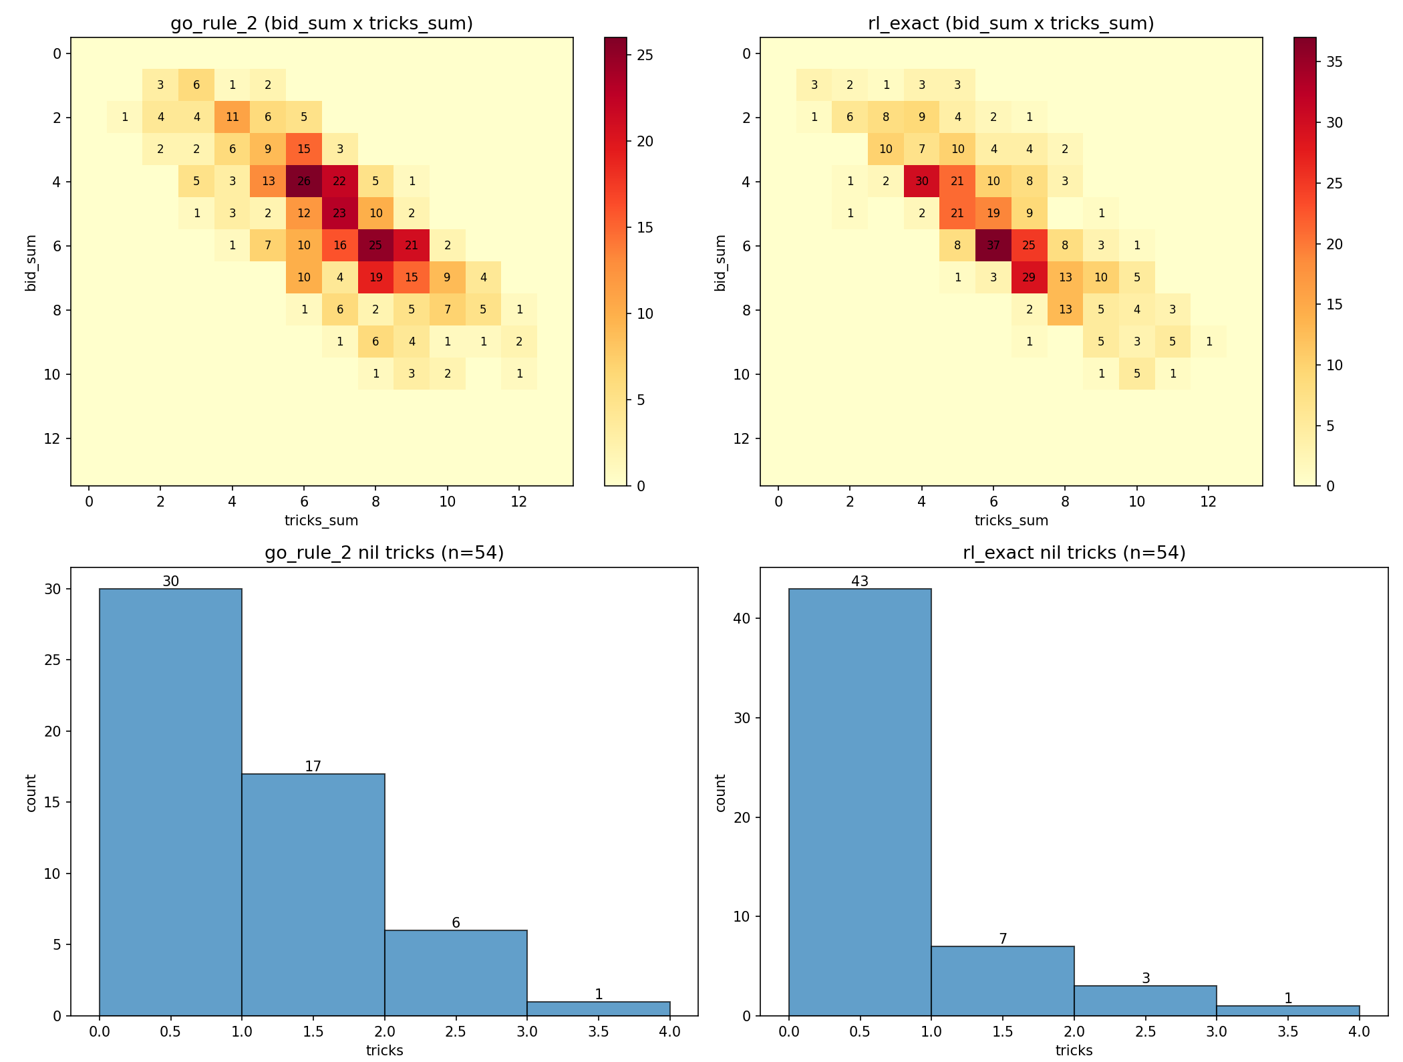
Experimental Results
Performance Evaluation and Error Metrics
CONTRACT FAILURE RATE (%)
15
12.0%
7.5
5.75%
0
RULE-BASED
RL-EXACT
Deep Learning Project Report
2026-06-06

Slide 8
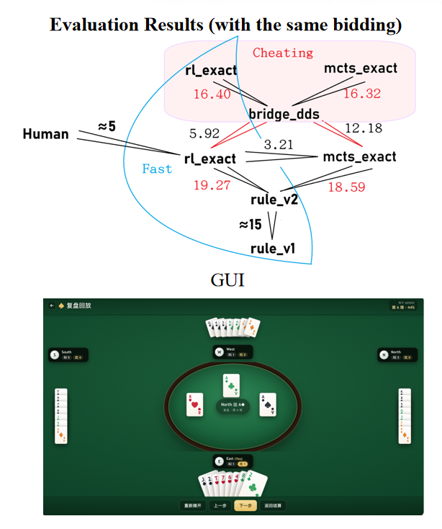
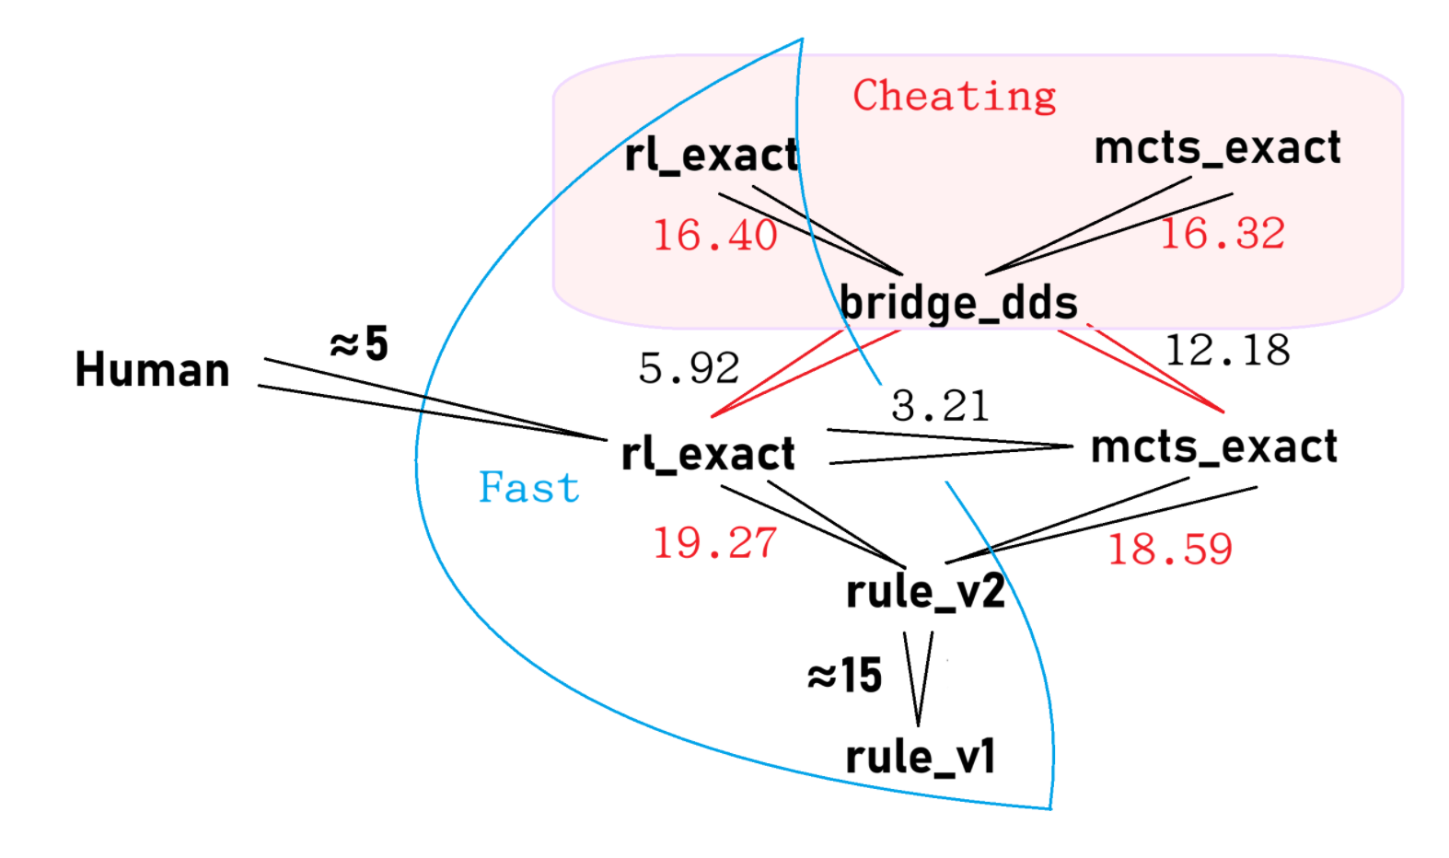
Experimental Results
Performance Evaluation and Error Metrics
Better than MCTS and Rule-Based baselines!
Deep Learning Project Report
2026-06-06
Evaluation Results (with the same bidding)

Slide 9
Takeaways
Framework Wrap-up and Future Implications
Integrating Solver or non-neural-network architectures is beneficial.
(Solver may be even faster than NNs.)
Inductive Bias accelerates training.
Deep Learning Project Report
2026-06-06

